Slide 1
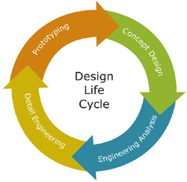
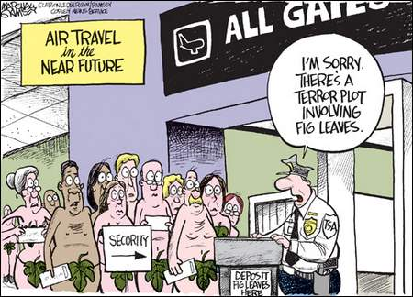
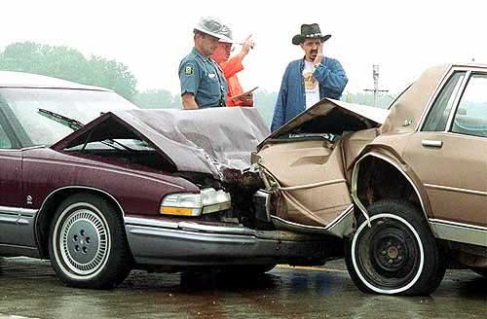
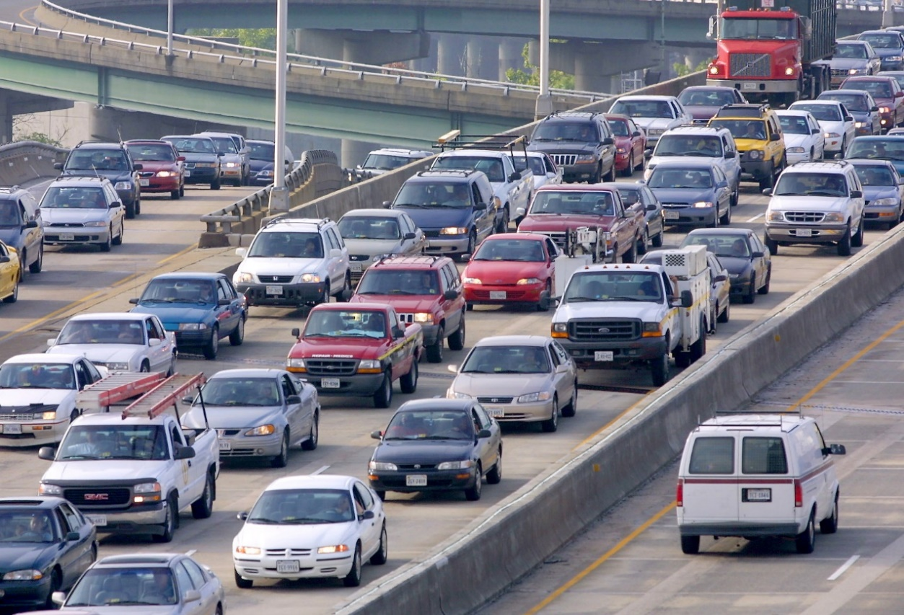
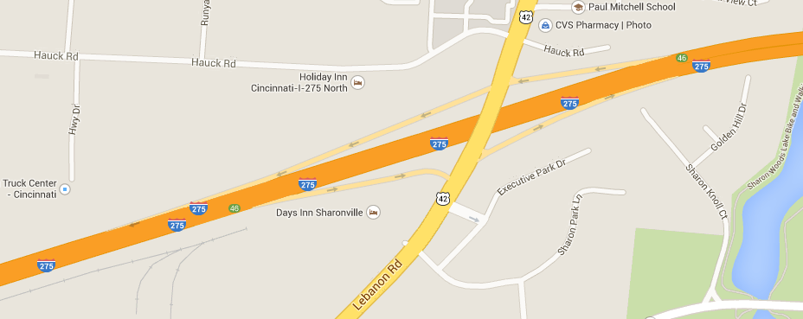
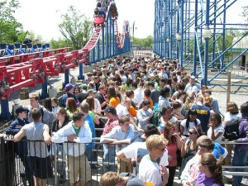
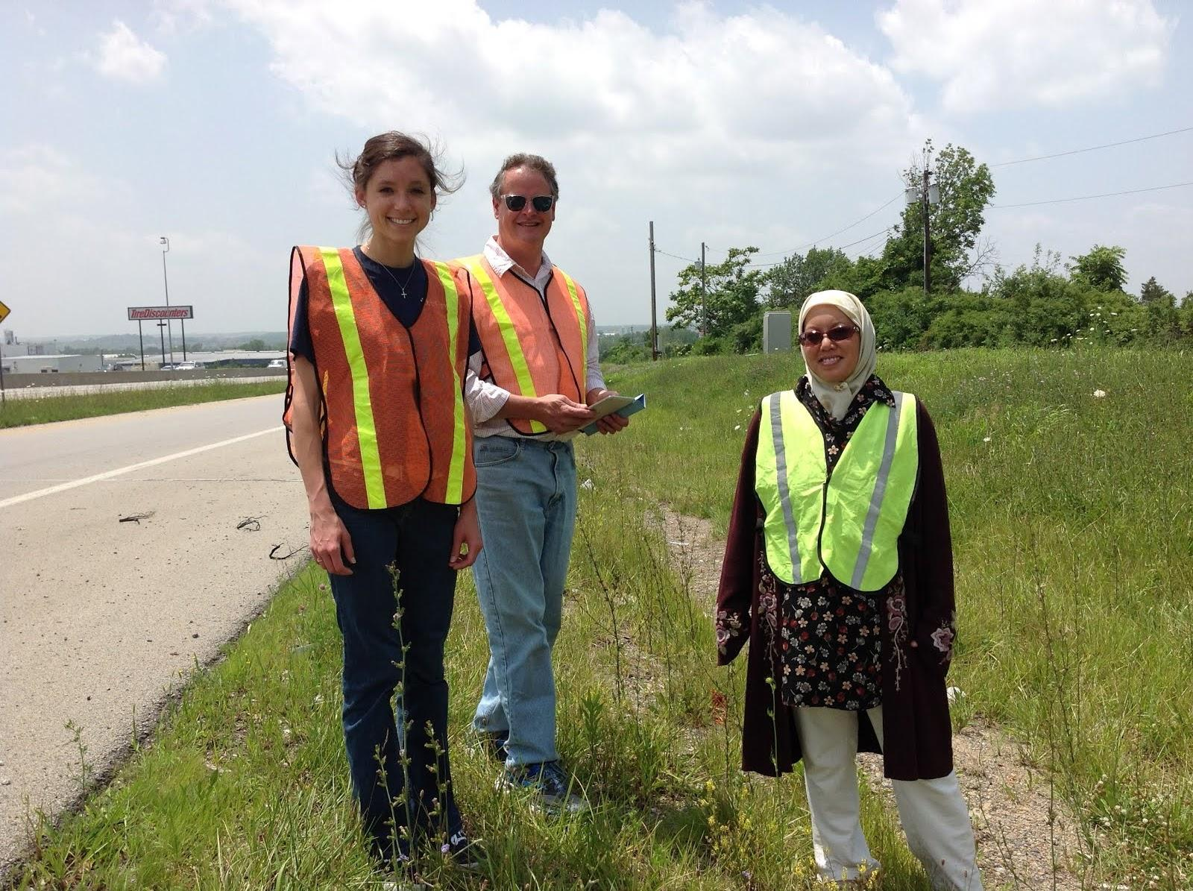
Life in the Fast Lane Bob Leugers School for the Creative & Performing Arts, Geometry
RET is funded by the National Science Foundation, grant # EEC-1404766
Traffic Jammin’
Challenge Based Learning
Waiting for What?
5.7 BILLION person hours wasted
in traffic congestion.
Rush to Work or from Work
Accidents
A single accident that blocks 1 lane on a 3 lane highway reduces
traffic flow by 50%. This is the leading cause of traffic congestion.
Ramp Meters to the Rescue?
WB & EBI-275 & Rt. 42
Staying on the Straight and Narrow
Isn’t The Best Path
ENGINEERING DESIGN PROCESS
TRAFFIC
Define Good & Bad Traffic
What Causes Traffic Congestion
How Can Traffic Be Managed
Simulation
Next…
Traffic volumes
between 7am-9am
between 4pm-6pm
Night & Weekends
Challenges Maximize Learning
Social Issue ➔ Ownership
Promotes Cooperation
You
Go
First!
GPS Data
Video Data
VISSIM Simulation
You are HERE!
Congestion
Simulation
Ramp Meter

